Slide 1
Fitnas of the Nafs

Slide 2
What is the Nafs?
Different from the heart (qalb)
Not tangible
Affects our personality, perceptions of good and bad, and reactions

Slide 3
Some Forces that Drive Us

Slide 4
Talents
Examples of Talents
Voice
Interpersonal skills
Writing
Speaking
Academic

Slide 5
Passions
Examples of Passions
Music
Religion
Sports
Reading
Teaching

Slide 6
Needs
Examples of Needs
Food
Money
Shelter
Marriage
Love

Slide 7
Conscience
Conscience
Guidance
Good/Bad
Consequences of actions

Slide 8
So to understand nafs…
Understand all the needs and forces that drive us!

Slide 9
The Interplay between the Forces
Needs
Talents
Passions
Conscience
voice
Common Area:
We take decisions here (with the VOICE of our conscience!)

Slide 10
This Common Area…
Is where Fitnahs of the Nafs arise!
We have to cater to so many needs at once
And at the same time listen to our conscience!

Slide 11
Three Types of Nafs
Nafs e Lawwama
Nafs e Ammara
Nafs e Mutma’innah

Slide 12
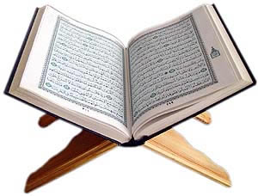
Nafs e Mutma’innah
يَا أَيَّتُهَا النَّفْسُ الْمُطْمَئِنَّةُ
ارْجِعِي إِلَىٰ رَبِّكِ رَاضِيَةً مَّرْضِيَّةً
“[To the righteous it will be said], O reassured soul, return to your Lord, well-pleased and pleasing [to Him].”
(Surah al Fajr, 89:26-27)

Slide 13
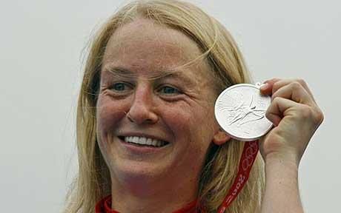
Analogy
A nafse mutma’innah is like a fully satisfied soul
Like when your name is called and you walk on stage to accept a rare and prestigious award
Knowing that after months and years of effort,
YOU MADE IT!!!
Very peaceful and satisfied state of heart

Slide 14
Qualities of Nafs e Mutma’innah
Very stable
Focused
Draws energy from obedience to Allah
Clear Vision
Satisfied with what it has
Dynamic/ On the Go
Happy
NOT confused
NOT wishing for something else all the time!

Slide 15
What Leads to Nafs e Mutma’innah?
No Doubts
Knows Allah
Knows right and wrong
Attains the right knowledge
Good grip over what he/she knows
Focus – this cannot come without studying Quran through and through!
Not switching from scholar to scholar
Repentance
Strong concept of accountability
Don’t need to prove yourself right –admit your faults!
Truthful
First to your OWN self!
As-sideeq: truthful in personality AND dealings

Slide 16
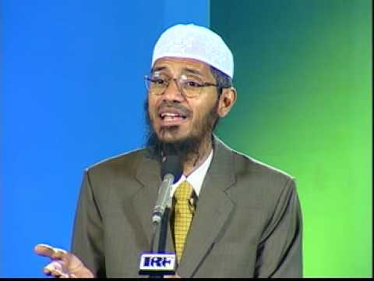
So a nafs e mutma’innah is…
A VERY dynamic personality
With a lot of awakening
Can manage all their needs, passions, talents
Without ignoring the conscience
And without wasting themselves!
Confident about all they do
No inferiority complex because of hijab, namaz, modesty etc!

Slide 17
Now the other extreme…
Nafs e Ammara
A Dead heart

Slide 18
What is a Nafs e Ammara?
إِنَّ النَّفْسَ لَأَمَّارَةٌ بِالسُّوءِ إِلَّا مَا رَحِمَ رَبِّي
Indeed, the soul is a persistent enjoiner of evil, except those upon which my Lord has mercy.
Surah Yusuf, 12:53

Slide 19
Qualities of Nafs e Ammara
Dead heart
Only Cares about itself
Ungrateful
Disobedient to Allah
Calls itself “self made”
Slave to desires
No limit to desires
No guilt!
Religion is nothing

Slide 20
Some slogans of Nafs e Ammara
It ‘s MY life!
Jaisay Chaho Jiyo! (Live as you wish)
Do what you want – you only live once!
I’m a SELF-MADE man/woman

Slide 21
The Third Type: Nafse Lawwama
In between

Slide 22
The Quran Mentions it
وَلَا أُقْسِمُ بِالنَّفْسِ اللَّوَّامَةِ
And I swear by the reproaching soul
Surah al Qiyamah, 75:2

Slide 23
Qualities of Nafs e Lawwama
Regret
Guilt
Wavering between good and bad

Slide 24
Link Between Driving Forces and Nafs
Some Examples

Slide 25
Someone has an Interest in Music
Need
Talent
Passion
Conscience
Money/Fame: Musical career can give both
Compostion, singing,
What goes INSIDE the conscience:
Knowledge about whether music is halal or haram
Music/
Singing

Slide 26
What Type of Nafs do You Become?
Depends on your conscience!
For example:
Nafse Ammara:
The knowledge going inside is wrong/insufficient
So the conscience tells you to go ahead in a musical career
And you become nafse ammara
No guilt!

Slide 27
Another Example

Slide 28
So A Girl Want to Get Married…
Need
Talent
Passion
Conscience
Marriage/
Love
Dress well
Talk well
Flirt?
Be smart!
What goes INSIDE her conscience:
Knowledge about her limits of interaction with men
Handsome, rich, educated, loving husband

Slide 29
What Does the Conscience say?
Nafse Ammara:
Grab him/her!
Even if you have to break his/her marriage
Wear what he likes
Talk how he likes

Slide 30
What Does the Conscience say?
Nafse Mutma’innah:
Very stable and unemotional
Pray to Allah and trust Him
Keep to your limits

Slide 31
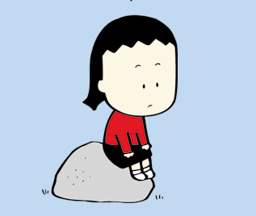
What Does the Conscience say?
Nafse Lawwama:
Madly in love
Yet always guilty
Confusion and heartache!

Slide 32
What to Do?
How to Control the Nafs?

Slide 33
Don’t Become a Nafse Ammara!
Then you can’t do ANYTHING!
Your heart is DEAD!
You don’t WANT to obey!

Slide 34
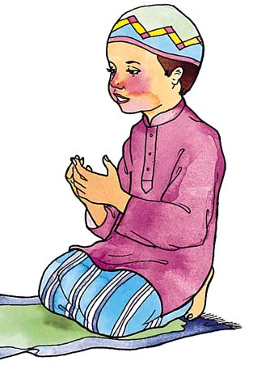
So to avoid that…
Don’t ignore your conscience
Don’t get irritated and stubborn when you get good advice
Listen to what is right
Make dua to save you from dead heart!

Slide 35
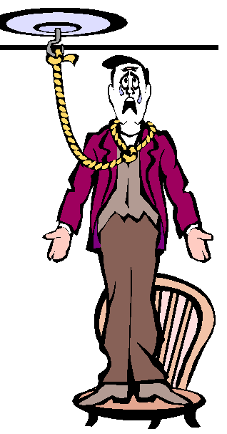
If you become a nafse Ammara:
Nothing in this life will satisfy you
Because if it did…
Then why the suicides among the rich and famous?
You’ll always have a void in your heart
Misery in duniya + Misery in akhirah!

Slide 36
So the true Fitna of the Nafs…
Is the suppressing of the conscience!

Slide 37
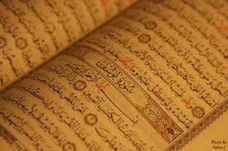
So sharpen your conscience
How?
Can’t do it without Quran and hadith!
Beg Allah for help!

Slide 38
Doesn’t mean let go of your talents and passions
Don’t waste yourself!
If Allah hadn’t wanted us to use our passion/talent
He would have made us potatoes, not humans!

Slide 39
If you’re falling into the lawwama category…
See where the guilt is coming
See where you’re going wrong
Need, passion, or talent?
Which is messed up?
Let your CONSCIENCE guide you!

Slide 40
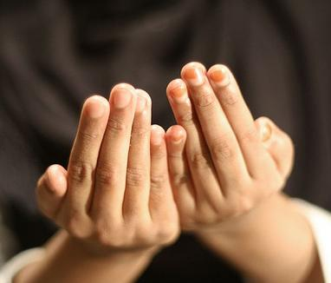
Make this Dua

