Slide 3
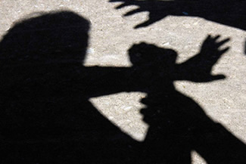
The Quran Tells us…

Slide 4
No Guidance for the Wrong Doers!
And Allah does not guide the wrongdoing people. (Ale-Imran:86)

Slide 5
Allah’s Curse is upon wrong doers!
Unquestionably, the curse of Allah is upon the wrongdoers.(Hud:18)

Slide 6
Wrong doers are deprived of Allah’s Love
And Allah does not like the wrongdoers
(Ale Imran: 57)

Slide 7
Severe and Lasting Punishment!
Unquestionably, the wrongdoers are in an enduring punishment.
(Ash Shoora : 45)

Slide 8
Neither Friend nor Intercessor!
For the wrongdoers there will be no devoted friend and no intercessor [who is] obeyed
(Ghafir 40:18)

Slide 9
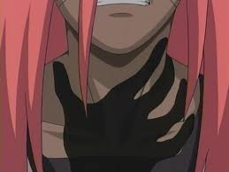
Consequences for the Zalimeen

Slide 11
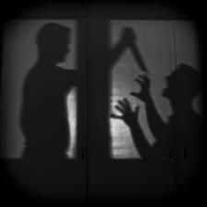
Allah has Banned Zulm!

Slide 12
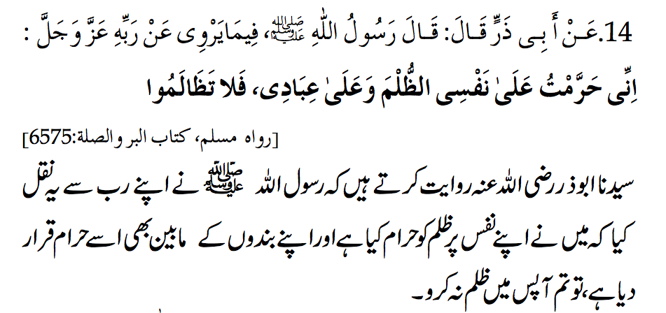
Allah has Banned Zulm!

Slide 13
ALLAH HAS CREATED EVERY THING ON JUSTICE
لَا الشَّمْسُ يَنبَغِي لَهَا أَن تُدْرِكَ الْقَمَرَ وَلَا اللَّيْلُ سَابِقُ النَّهَارِ ۚ وَكُلٌّ فِي فَلَكٍ يَسْبَحُونَ [٣٦:٤٠]
It is not permitted to the Sun to catch up the Moon, nor can the Night outstrip the Day: Each (just) swims along in (its own) orbit (according to Law). (Surah Yaseen : Ayah 40)

Slide 14
Too much Zulm Around us?

Slide 15
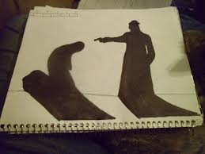
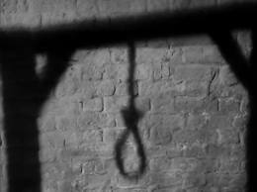
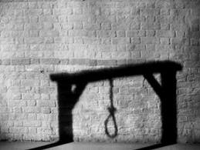

Slide 16
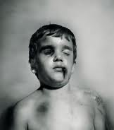
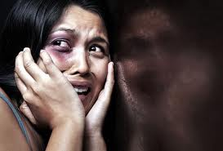
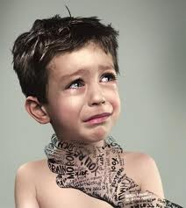
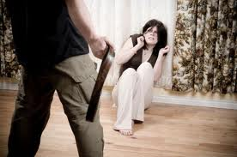

Slide 17
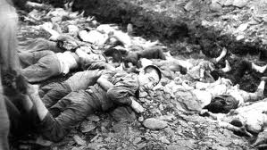
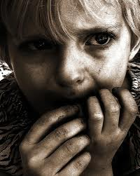
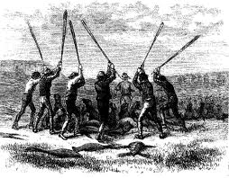
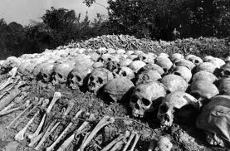

Slide 18
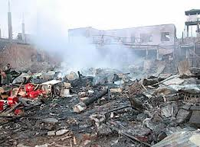
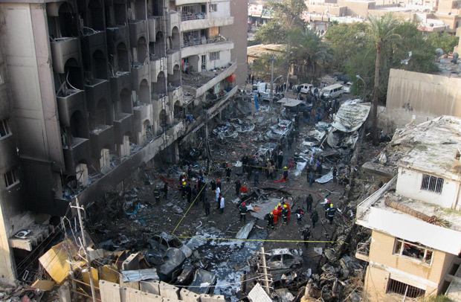
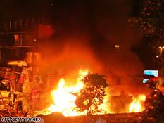
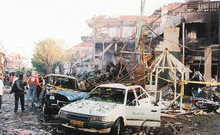

Slide 19
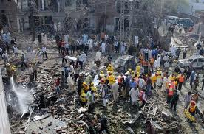
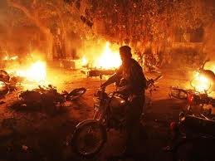
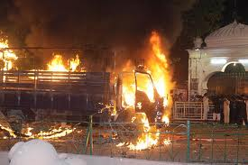
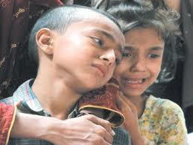
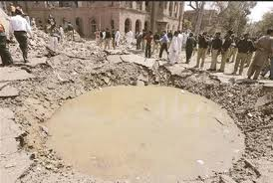
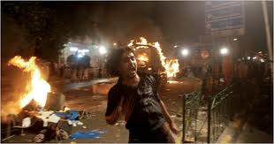

Slide 20
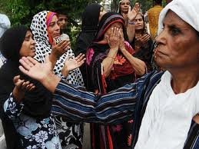
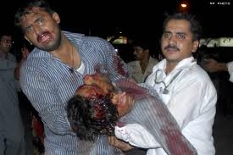
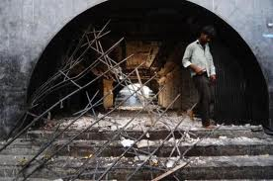

Slide 21
A DEEPER LOOK

Slide 22
Zulm Elaborated!

Slide 23
Linguistic Definition
“To change the original place of something”

Slide 24
KINDS OF ZULM
Life
Property
Rights
Honour
ZULM

Slide 25
WHAT IS ZULM
To excced limits.
To create imbalance in rights (Haq).
To be self centred.
Imbalance of time.

Slide 26
ZULM
Can be with
As well as with
Creation
Creator

Slide 27
Creator
Not to understand the rights and value of the Creator.
Creation
Not to give rights to the creation (humans, animals, etc)

Slide 28
ZULM....where limits exceeded
To interfare in someone’s work.
To smell bad in public.
To leave own work and do other people’s work.
To donate charity outside the family when you own family is deserving.
To priortise other duty then your own duty.
No limits on use of resources.

Slide 29
ZULM....where rights not fulfilled
To demand own right and not fulfill others.
To place excessive demands from others.
To highlight one right and undermine others.
To give right of one person and ignore others.
Important to know rights and responsibilites in each relation.

Slide 30
Save yourself ! Protect your good Deeds!

Slide 31
ZULM....where time wasted
To waste anyone’s time.
To indulge in time wasters.
To be vague about prirotizing time.
To be yes-man all the time.
Even to waste your own time and talent is included in zulm :o

Slide 32
Zulm With Property Includes....
Using the available resources beyond our needs e.g natural resources
Giving less then the stated right in inheritence to sisters or forcefully made a woman declare their share of inheritance as of his brothers.
Not giving the right to woman incase her husband died.
Manupulate parents for warasat.

Slide 33
Consequences of Zulm!

Slide 34
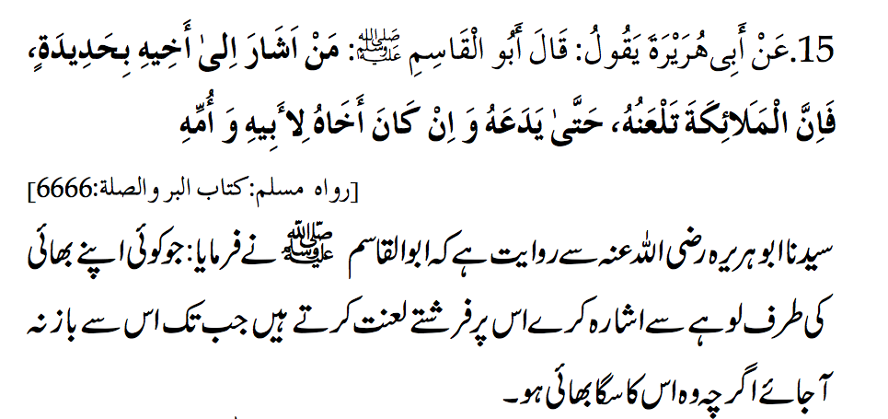
Curse by the Angels!

Slide 35
Emotional Zulm...
To make fun of anyone / anyone’s name
To be sarcastic/ To accuse / To satire
To taunt / To humilate
To abuse verbally
To backbite
To expose others’ weakness again and again

Slide 36
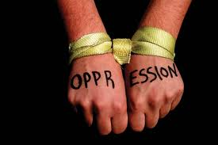
Can i do zulm with Myself...???
The answer is.....

Slide 37
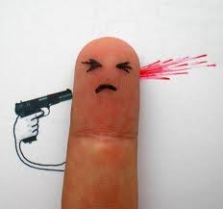
Yes...!!

Slide 38
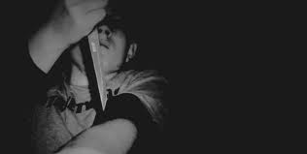
How...???

Slide 39
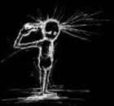
Zulm ON ONESELF
To ignore Religious Obligations
Not to take care of health
Not to Take care of Cleanliness
Not to cut nails weekly
To ignore cleanliness of hair and clothes
Physical
Spritual
e.g. eating junk food
Mental
Not to read Quran daily
Not to read knowledgable books
Not to Pray Namaz on time or 5 times
Not to pay Zakat
Not to Fast

Slide 40
Zulm - Darkness

Slide 41
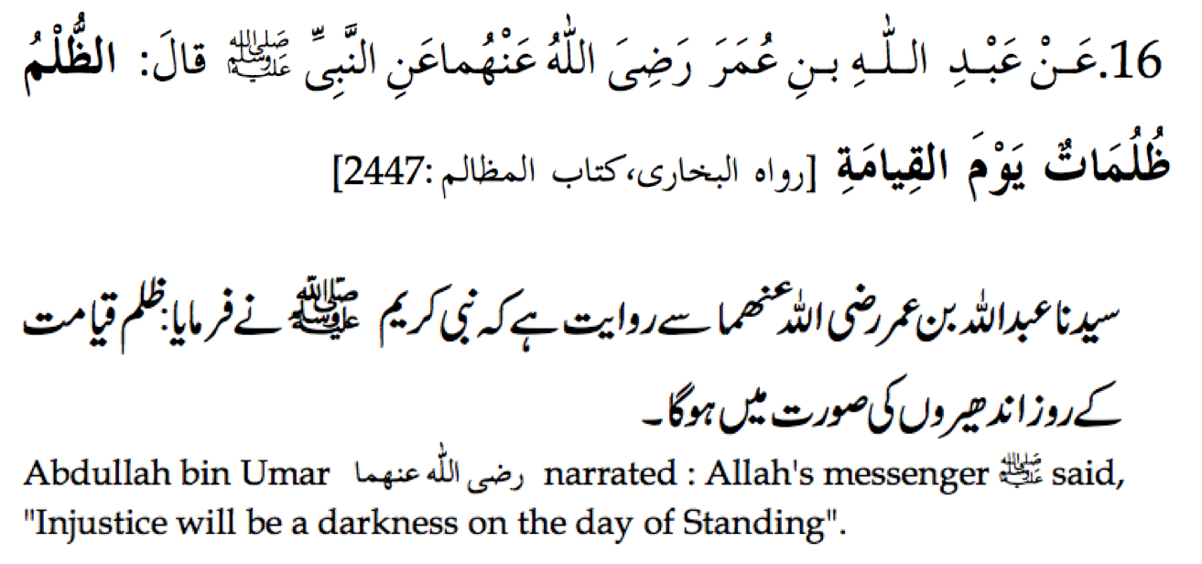
Zulm = Darkness

Slide 42
How to minimize zulm in our lives

Slide 43
Fear the Plea of the Mazloom!

Slide 44
Help the Zaalim, Not Just the Mazloom!

Slide 45
Importance of seeking permission!

Slide 46
Key to Achieve Excellence in Imaan!

Slide 47
Save yourself from Hellfire!

Slide 48
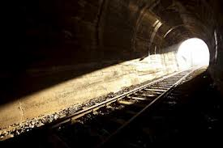
What forms of Zulm we MUST minimize and how?

Slide 49
To Minimize Zulm With Parents
To talk to them with politeness
Ask for forgiveness and give charity from their side after their death
Donot consider them like they don’t know anything
To be thankfull and obedient towards them
Avoid unnecessary complains
Minimize the tone in which you talk to your parents

Slide 50
TO Minimize ZULM WITH FRIENDS
Do not put ur work on others. Fullfill ur duty on time.
Do not create disturbance for them
Do not impose your willl on them
Return the things you have borrowed from them on time
By induldging them into useless talk
Calling them at wrong time
Do not waste their time e.g

Slide 51
TO Minimize ZULM WITH children
Do not hit them unnecessarily
Create justice between your children
Do not shout at them unnecessarily

Slide 52
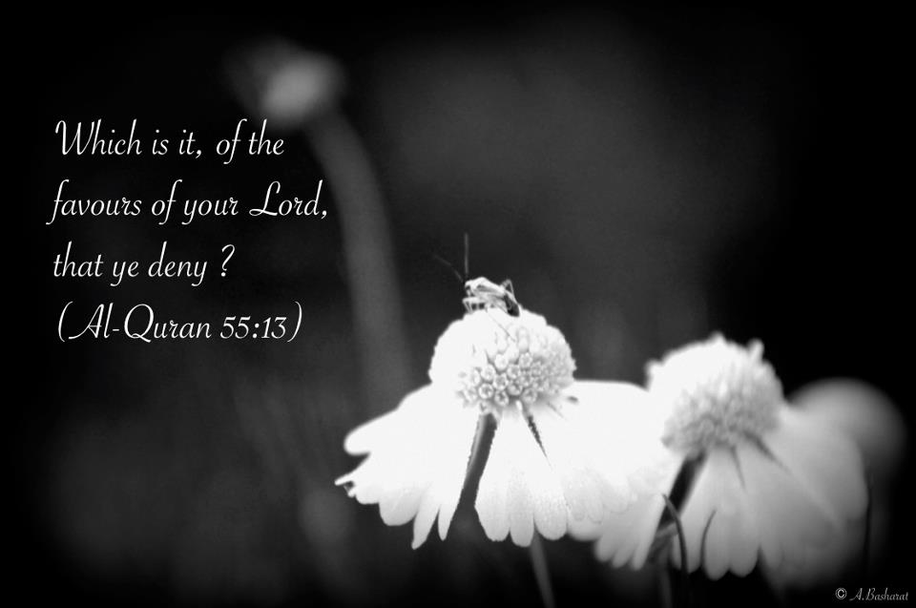
Conclusion

Slide 53
Activity…..
Make a list of important relations including 24 hr relations in your life
Mark them on pie chart according to how much time you give to them
With each relation write one thing you do for them.
Think again and add one thing you feel you need to do.
Make that target for the week and keep adding more targets each month.

