Slide 1
Habit 2 Begin with End in Mind
Dr. Kanwal Kaisser

Slide 2
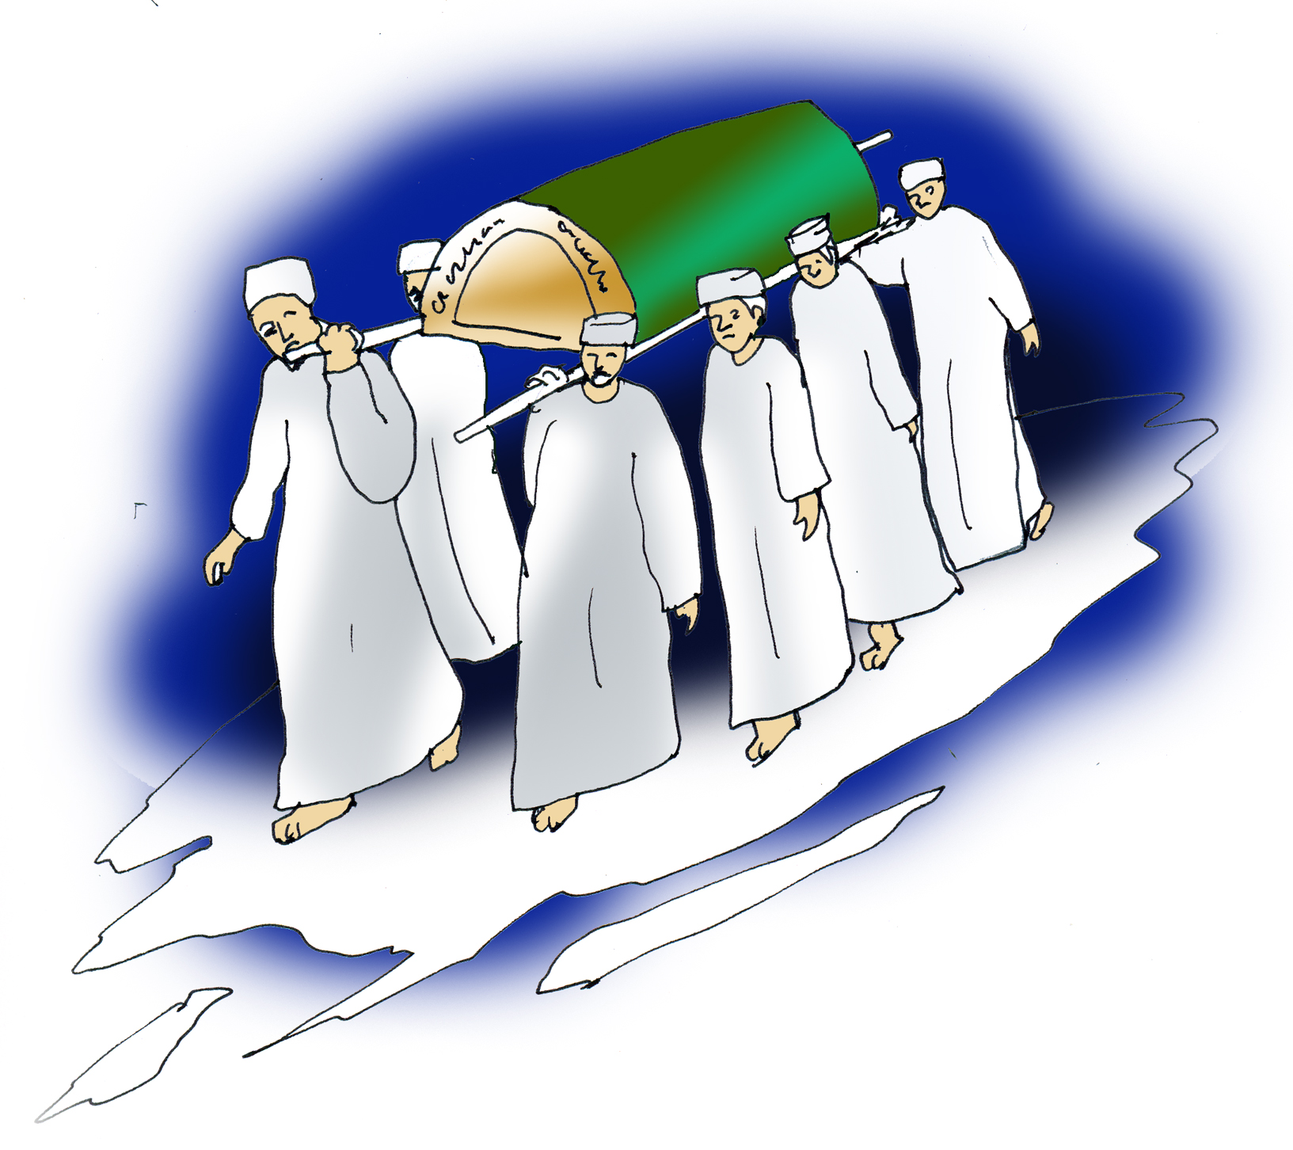
Family
Friend
Coworker
Islamic community
Notes:
Character, achievement, contribution …difference you made in their lives
Write down points…

Slide 3
What we leave behind
It was narrated that Abu Hurairah said:
"The Messenger of Allahﷺ said: 'The rewards of the good deeds that will reach a believer after his death are: Knowledge which he taught and spread; a righteous son whom he leaves behind; a copy of the Qur'an that he leaves as a legacy; a mosque that he built; a house that he built for wayfarers; a canal that he dug; or charity that he gave during his lifetime when he was in good health. These deeds will reach him after his death.'” (Ibn majah)

Slide 4
Inner Guidance system
Circle of Concern
Circle of Influence

Slide 5
Habit 2 in Our Paradigms
Begin with end in Mind
Feeling
Thoughts
Behavior
Notes:
Image, picture, paradigm of the end of your life

Slide 6
Understanding your destination
اهْدِنَا الصِّرَاطَ الْمُسْتَقِيمَ
Show us the straight way, (1:6)
كُلُّ نَفْسٍ ذَائِقَةُ الْمَوْتِ ۗ وَنَبْلُوكُم بِالشَّرِّ وَالْخَيْرِ فِتْنَةً ۖ وَإِلَيْنَا تُرْجَعُونَ
Every soul shall have a taste of death: and We test you by evil and by good by way of trial. to Us must ye return.(Al-Anbiyaaa:35)
Notes:
Victories at expense of valuable things in life

Slide 7
What is deeply important for you?
Busy
Efficient
Effective

Slide 8
All things are created twice
Measure twice and cut once

Slide 9
Personal Leadership
Mental… First creation
Physical… Second creation
Notes:
Making house, starting a business, parenting and kids education
First creation: Leadership…..doing the right things
Second creation: management…..Doing things right

Slide 10
What is Jannah
Abu Hurayrah, ra, reported that the Messenger of Allahﷺ , said, "Allah, the Exalted, has said: 'I have prepared for my righteous slaves what no eye has seen, no ear has heard, and the mind of no man has conceived.' If you wish, recite:
'No person knows what is kept hidden for them of joy as a reward for what they used to do.' " [Al-Bukhari, 32:17]

Slide 11
Shahabah used to smell Jannah
It was narrated from Anas bin Malik that the Messenger of Allah (ﷺ) said:
“There are three things, whoever has them has found the taste of faith (One of the narrators) Bundar said: ‘The sweetness of faith; When he loves a man and only loves him for the sake of Allah. When Allah and His Messenger are more beloved to him than anything else; and when being thrown into the fire is dearer to him than going back to disbelief after Allah has saved him from it.”
(Ibn Majah)

Slide 12
By Design or Default?
People
Circle of Concern
Circle of Influence
Principles
Notes:
We reactively live by the script handed to us by family/people/circumstances/past habits

Slide 13
Stimulus
Response
Self Awareness
Conscience
Imagination
Will Power
Notes:
Habit 1: you are creator
Habit 2: your first creation

Slide 14
Leadership vs Management

Slide 15
Parenting Leadership vs Management

Slide 16
Working Leadership vs Management

Slide 17
Habit 2 Management Paradigm
Begin with end in Mind
Control
Efficiency
Rules

Slide 18
Habit 2 Leadership Paradigms
Begin with end in Mind
Direction
Purpose
Family Feeling
Notes:
Win war, not battle

Slide 19
Re-Scripting
يَا أَيُّهَا الَّذِينَ آمَنُوا قُوا أَنفُسَكُمْ وَأَهْلِيكُمْ نَارًا)At-Tahrim:6(

Slide 20
Security
CENTER
Wisdom
Guidance
Power
Notes:
Security: Sense of worth
Guidance: Source of direction
Wisdom: Balance
Power: capacity to act

Slide 21
Alternative Centers
Recognize your Centre

Slide 22
Security
Spouse
Centeredness
Wisdom
Guidance
Power

Slide 23
Most Enduring Growth-producing relationship
And of His signs is that He created for you from yourselves mates that you may find tranquillity in them; and He placed between you affection and mercy. Indeed in that are signs for a people who give thought.
(Ar-Rum:21)

Slide 24
A different Story
Strong Emotional Dependence
Vulnerable to moods, feelings, behavior and treatment of spouse
Increase in responsibilities and we revert to our old behavior
Need and conflict are compounded
Love-Hate, bitterness, aggressiveness, withdrawal, resentment shows
Resort to sarcasm, cutting humor, criticism

Slide 25
Spouse Centeredness
Security: phantom
Guidance: Based on emotion of moment
Wisdom: Lost
Power: Negative interaction

Slide 26
Security
Family
Centeredness
Wisdom
Guidance
Power

Slide 27
Accountability on Silah Rahmi
O mankind, fear your Lord, who created you from one soul and created from it its mate and dispersed from both of them many men and women. And fear Allah , through whom you ask one another, and the wombs. Indeed Allah is ever, over you, an Observer. (An-Nisa:1)

Slide 28
Family Elements
Vulnerable to Family cultures
No emotional freedom
No power to raise kids as they like
They become upset, reacting immediately to concern
May yell, scream or over-react at kid
Love children conditionally

Slide 29
Family Centeredness
Security: Family tradition, culture, repute
Guidance: What family considers right
Wisdom: Family narcissism
Power: Limited actions

Slide 30
Security
Money
Centeredness
Wisdom
Guidance
Power

Slide 31
Virtues of Spending
Who spend [in the cause of Allah ] during ease and hardship and who restrain anger and who pardon the people - and Allah loves the doers of good; (Ale-Imran:134)

Slide 32
Money Obsession
Many people face economic worries
Anxious, uneasy, protective, defensive
Often put aside family and other priorities

Slide 33
Money Centeredness
Security: Limited…. Assessed by money
Guidance: Profit
Wisdom: Money making lens
Power: Temporary

Slide 34
Security
Work
Centeredness
Wisdom
Guidance
Power

Slide 35
Hard Work Appreciated
And that there is not for man except that [good] for which he strives (An-Najm:39)

Slide 36
Work =Life
Workaholics
Sacrifice of health, relationships and other important areas of life
Fundamental identity comes from work

Slide 37
Work Centeredness
Security: Only comfortable when working
Guidance: Based on needs and expectations of work
Wisdom: Work is life
Power: Actions limited by work role models

Slide 38
Security
Possession
Centeredness
Wisdom
Guidance
Power

Slide 39
Balance in Materialism
And whatever thing you [people] have been given - it is [only for] the enjoyment of worldly life and its adornment. And what is with Allah is better and more lasting; so will you not use reason? (Al-Qasas:60)

Slide 40
Driving force
Tangible: clothes, cars, home, jewelry etc
Intangible: fame, glory, social prominence
Very superficial Center

Slide 41
Possession Centeredness
Security: Social Status, Compare what you have and what others have
Guidance: Based on what will protect, increase or better display your posessions
Wisdom: See world in terms of comparative economic and social relationships
Power: From material or social prominence

Slide 42
Security
Pleasure
Centeredness
Wisdom
Guidance
Power

Slide 43
Pleasures of this life
And the worldly life is not but amusement and diversion; but the home of the Hereafter is best for those who fear Allah , so will you not reason? (Al-An’am:32)

Slide 44
Fun and Pleasure
Instant gratification is available and encouraged
Media being major influencer
Life style graphically portrayed but natural result is seldom accurately seen
No deep and lasting fulfillment in life
Narcissistic attitude

Slide 45
Pleasure Centeredness
Security: Short lived and anesthetizing
Guidance: Based on what gives most pleasure
Wisdom: What is in it for me
Power: Negligible

Slide 46
Security
Friend/Enemy
Centeredness
Wisdom
Guidance
Power

Slide 47
Criterion of Friendship
وَتَعَاوَنُوا عَلَى الْبِرِّ وَالتَّقْوَىٰ ۖ وَلَا تَعَاوَنُوا عَلَى الْإِثْمِ وَالْعُدْوَانِ ۚ
And cooperate in righteousness and piety, but do not cooperate in sin and aggression
(Al-Ma’idah:2)

Slide 48
Love Hate Friendships
Mostly young people
High degree of dependence on moods, behaviors, feelings and attitudes of others
Enemy Centeredness is very common
Preoccupied with injustice of enemy

Slide 49
Friend/Enemy Centeredness
Security: Dependent/Volatile
Guidance: What will they think?/What will thwart them?
Wisdom: Social Lens/Defensive, over reactive, paranoid
Power: Social comfort zone/Anger, envy, resentment

Slide 50
Security
Religious
Centeredness
Wisdom
Guidance
Power
Notes:
Security: Sense of worth
Guidance: Source of direction
Wisdom: Balance
Power: capacity to act

Slide 51
Enter into Islam fully
O you who have believed, enter into Islam completely [and perfectly] and do not follow the footsteps of Satan. Indeed, he is to you a clear enemy.(Al-Baqarah:208)

Slide 52
Balance of Rights and Responsibilities
Obsessed with worship and projects
Insensitive to pressing human needs around them
Often live in compartments, acting and thinking and feeling in certain ways in religious gatherings and totally different ways in other places

Slide 53
Religious Centeredness
Security: Religious labels and comparisons
Guidance: How others will evaluate your actions in light of religious teaching
Wisdom: See life as ‘Believers’ and ‘Non Believers’
Power: Perceived

Slide 54
Security
Self
Centeredness
Wisdom
Guidance
Power

Slide 55
Islam Protects from Stinginess
وَمَن يُوقَ شُحَّ نَفْسِهِ فَأُولَٰئِكَ هُمُ الْمُفْلِحُونَ
And whoever is protected from the stinginess of his soul - it is those who will be the successful.(Al-Hashr:9)

Slide 56
Selfishness at Peak
Most common center
Violates the values of most people

Slide 57
Self-Centeredness
Security: Constant change and shift
Guidance: If it feels good/ What I want/ What I need/What’s in it for me?
Wisdom: View world how anything affects you
Power: Limited to own resources and no interdependence

Slide 58
To get in touch….
Dr. Kanwal Kaisser
Dr. Kanwal Kaisser @ HamarayBachchay
hbheadoffice@gmail.com

