Slide 1
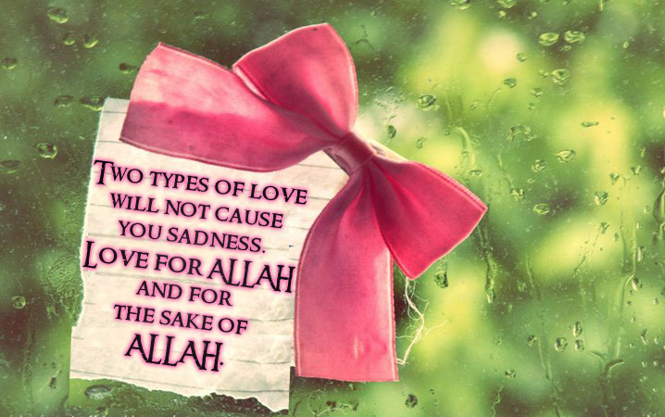
Emotions of Love
Dr. Kanwal Kaisser
Notes:
To view this presentation, first, turn up your volume and second, launch the self-running slide show.

Slide 2
Series Includes…...
What is haya?
Emotions of Love
Veiled threats to Haya
Unspoken Desires
Handling Peer pressure
Hijab

Slide 3
It was narrated from ‘Uqbah bin ‘Amr, Abu Mas’ud, that the Messenger of Allah (ﷺ) said:
“Among the words that people learned from the earlier Prophets are: ‘If you feel no shame, then do as you wish.’”
(Ibn Majah)

Slide 4
What is Love??

Slide 5
Love is ………
Fascinating
Complex
Mystery
Puts one on cloud 9

Slide 6
Brain on love….

Slide 7
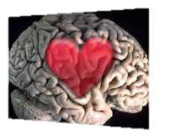
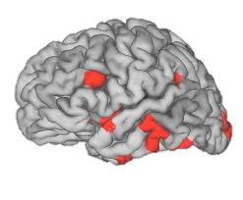
Brain on love….
Romantic love acts as motivational drives that are part of the brain's reward system.
(The Brain in love)
Human brain supports falling in love, so, a strong physiological response seen, when we attracted to someone.
World is seen through the lens of love: everything is tolerable and everything partner does is delightful .
(Kane, Family Therapist).

Slide 8
Not a random process at all but it has rules that govern it.
Time has a wonderful way of showing us what really matters..

Slide 9
Love at first sight….
Related to how mind works.
QUESTION
Why ‘He’ and no one else?
A checklist stored in our mind.
Checklist is unique and specific, depending on background, values, past experiences and beliefs.
People are usually unaware of their subconscious criteria.

Slide 10
Warning !!!
WARNING: If your criteria depends heavily on looks then your chance of falling in love at the first sight will be much higher than that of a person who gives higher priority to personality or other qualities.

Slide 11
The Magic of Idealization

Slide 12
Idealization set back
We are especially prone to idealizing moments of the past.
Research has shown that most of us desire a partner who is among other qualities, attractive, trustworthy, warm, successful, and intelligent.
Our memories also undergo several edits and re-writes as new information is added.
Idealization occurs when we generate positive illusions by maximizing virtues and minimizing flaws.
Notes:
While our hearts are busy submerged in the glory of attraction, the phenomenon of idealization may insidiously creep into our cerebral systems.

Slide 13
unrealistically disillusioned lovers
With appropriate levels of idealization, we reconstruct our memories to believe that the qualities we've found in a person are the ones of value to us.

Slide 14
Channels that affect our subconcious mind
MOVIES
NOVELS
SONGS
WEDDINGS
EDUCATIONAL INSTITUTION ATMOSPHERE
PEER PRESSURE
ENTERTAIN-MENT

Slide 15
WHERE DO WE LOOK FOR SUCH LOVE….
Weddings
Educational Institution
Islamic Forums
Social Networking Sites
Chats
Facebook

Slide 16
Relationship myths
A GREAT RELATIONSHIP……
Is great meeting of mind
Require great romance
Requires common interests
It will let you vent all feelings
Has nothing to do with sex
Means straighten your partner

Slide 17
How children develop Love Connections?

Slide 18
Parental Influence on Kids emotional needs
A study investigating the connection between parent’s investment and children’s competence suggests that the emotional involvement of parents really does matter and affects the outcome of their child’s emotional competence and regulation (Volling, 458)
Depressed mothers have maladaptive thoughts, attitudes, and behaviors, and these, along with being in a similarly stressful environment as the mother, put a child at risk of developing his own emotional problems (Sroufe 204)

Slide 19
Purpose of Attachment
Not to play with or entertain the child
Not to feed the child
Not to set limits for the child
Not to teach the child new skills
Attachment is a heaven of safety and a source of comfort

Slide 20
Some tips…
The quality of the infant-parent attachment is a powerful predictor of a child’s later social and emotional outcome.
By definition, a normally developing child will develop an attachment relationship with any caregiver who provides regular physical and/or emotional care, regardless of the quality of that care.
Children develop a hierarchy of attachments with their various caregivers.

Slide 21
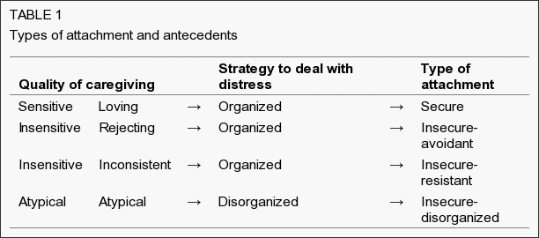
making the child safe, secure and protected

Slide 22
Secure Attachment
Caregivers respond: Sensitive or ‘loving’ ways
Actions: Picking the infant up promptly and reassuring the infant
Feel secure: Comfort from the caregiver
Strategy: ‘organized’ because the child ‘knows’ exactly what to do with a sensitively responsive caregiver
Notes:
Caregivers respond to distress in sensitive or ‘loving’ ways
Picking the infant up promptly and reassuring the infant
Feel secure in their knowledge that they can freely express negative emotion which will elicit comforting from the caregiver
They seek proximity to and maintain contact with the caregiver until they feel safe.
The strategy is said to be ‘organized’ because the child ‘knows’ exactly what to do with a sensitively responsive caregiver, ie, approach the caregiver when distressed.

Slide 23
Insecure Attachment
Caregivers response: Insensitive or ‘rejecting’ ways
Actions: Ignoring, ridiculing or becoming annoyed
Feel Secure: They avoid their caregiver when distressed and minimize displays of negative emotion in the presence of the caregiver
Strategy: ‘organized’ because the child ‘knows’ exactly what to do with a rejecting caregiver
Increases the risk for developing adjustment problems.
Notes:
Infants whose caregivers consistently respond to distress in insensitive or ‘rejecting’ ways
Ignoring, ridiculing or becoming annoyed
Develop a strategy for dealing with distress that is also ‘organized’, in that they avoid their caregiver when distressed and minimize displays of negative emotion in the presence of the caregiver
The strategy is said to be ‘organized’ because the child ‘knows’ exactly what to do with a rejecting caregiver, ie, to avoid the caregiver in times of need.
This avoidant strategy is also ‘insecure’ because it increases the risk for developing adjustment problems.

Slide 24
Inconsistent Attachment
Caregivers response: Inconsistent, unpredictable and/or ‘involving’ ways
Actions: Expecting the infant to worry about the caregiver’s own needs or by amplifying the infant’s distress and being overwhelmed
Feel Secure: They display extreme negative emotion to draw the attention of their inconsistently responsive caregiver.
Strategy: ‘organized’ because the child ‘knows’ exactly what to do with an inconsistently responsive caregiver
Increase in the risk for developing social and emotional maladjustment.

Slide 25
Disorganized Attachment
Caretaker Response: Includes children’s exposure to specific forms of distorted parenting that are ‘atypical’
Actions: “frightening, frightened, dissociated, sexualized or otherwise atypical”
These are aberrant behaviours displayed by caregivers during interactions with their children that are not limited to when the child is distressed.
Often have a history of unresolved mourning or unresolved emotional, physical or sexual trauma, or are otherwise traumatized
Notes:
Approximately 15% of infants in low psychosocial risk and as many as 82% of those in high-risk situations do not use any of the three organized strategies for dealing with stress and negative emotion
Includes children’s exposure to specific forms of distorted parenting and unusual caregiver behaviours that are ‘atypical’
Atypical caregiver behaviours, also referred to as “frightening, frightened, dissociated, sexualized or otherwise atypical”
These are aberrant behaviours displayed by caregivers during interactions with their children that are not limited to when the child is distressed.
There is evidence to suggest that caregivers who display atypical behaviours often have a history of unresolved mourning or unresolved emotional, physical or sexual trauma, or are otherwise traumatized

Slide 26
Islam’s Perspective on Love
We fall in love by chance and stay in love by choice !!

Slide 27
Does ISLAM Allow Falling IN Love??????
Islam: Truthful and realistic.
Love is a feeling, which can be channelized into halal or haram direction.
We not accountable for feelings but action and nurturing of any feeling.
Human beings can experience a level of sustained deep emotional bonding and sexual pleasure far beyond the ability of any animal, but the responsibility is to direct our desires only in the manner set out for us by Allah.

Slide 28
Nature of love explained in Islam
Love in Islam
Ishq…….deeper love, obsession towards haram
Love
حب
عشق
وُد
Healthy, Intense love (esp b/w Husband,wife or Parents and Children).

Slide 29
Environmental control
Don’t Isolate yourself with opposite sex
Don’t get Carried away

Slide 30
When the Prophet (ﷺ) saw a young man merely looking at a young woman, he turned his head so as to make him look away, then he said:
“I saw a young man and a young woman, and I did not trust the shaytaan not to tempt them.”
( Al-Tirmidhi )

Slide 31
RasulAllah’s Expression of love!
Amr bin Aas came to the Prophet (ﷺ) after he gave Amr the commander of an expedition, and asked:
"O Rasulllah(ﷺ), who is the most beloved to you amongst all mankind?”
Rasullah (ﷺ) said:
"Aisha".
Amr said: "Then?"
Rasullah (ﷺ) said: "Her father"
(Sahih Bukhari)

Slide 32
Garments for Each Other
They are clothing for you and you are clothing for them.
(Al-Baqarah: 187)

Slide 33
How to handle love in Air?

Slide 34
Dilemmas of those involved!
Legally Involved
‘Illegally’ Involved!!!
Engaged!
Setting Limits
Uncertainty
Unhappy Parents
Feeling of ‘Sin’
False expectations
Phone/ Meet/ Chat
Handling demands

Slide 35
For those who are ‘not involved’
Still at risk
Make habit to be ‘pre-emptive’
Do not look down at trapped ones
We think its EASY not to be involved

Slide 36
How to manage Kids desires?

Slide 37
Desires Surrounding us!
In environment
وَلَا تَقْرَبُوا الزِّنَا إِنَّهُ كَانَ فَاحِشَةً وَسَاءَ سَبِيلً )17:32(
Block all roads
Connect to Quran
Keep watch on your company

Slide 38
Desires within us!
Justified
إِلَّا مَا قَدْ سَلَفَ إِنَّ اللَّهَ كَانَ غَفُورًا رَّحِيمًا )23: 4(
Early marriage
Fasting
Channelizing

Slide 39
How to satisfy need of love?
Love is like wind; you can’t see it but you know it’s there!!

Slide 40
True Love
وَمِنَ النَّاسِ مَن يَتَّخِذُ مِن دُونِ اللَّهِ أَندَادًا
يُحِبُّونَهُمْ كَحُبِّ اللَّهِ ۖ
وَالَّذِينَ آمَنُوا أَشَدُّ حُبًّا لِّلَّهِ ۗ
And [yet], among the people are those who take other than Allah as equals [to Him]. They love them as they [should] love Allah . But those who believe are stronger in love for Allah .
(Al-Baqarah:165)

Slide 41
Seeking Allah’s Love…through?
قُلْ إِن كُنتُمْ تُحِبُّونَ اللَّهَ فَاتَّبِعُونِي يُحْبِبْكُمُ اللَّهُ
وَيَغْفِرْ لَكُمْ ذُنُوبَكُمْ ۗ وَاللَّهُ غَفُورٌ رَّحِيمٌ
Say (O Muhammad ﷺ): "If you (really) love Allah then follow me, Allah will love you and forgive you of your sins. And Allah is Oft-Forgiving, Most Merciful.”
(Ale-Imran, 3:31)

Slide 42
Making the Impossible Possible!
Love for Allah
Love for Prophet
Love for Religion
Love for Family
Love for Humanity
Love in Islam is all-encompassing, comprehensive and sublime, rather than being restricted to one form only.

Slide 43
What Allah Commands?

Slide 44
We accept the love we think we deserve!!

Slide 45
To get in touch….
Dr. Kanwal Kaisser/ Hamaray Bachchay
Dr. Kanwal Kaisser @ HamarayBachchay
hbheadoffice @gmail.com
www.hamaraybachchay.com

