Slide 1
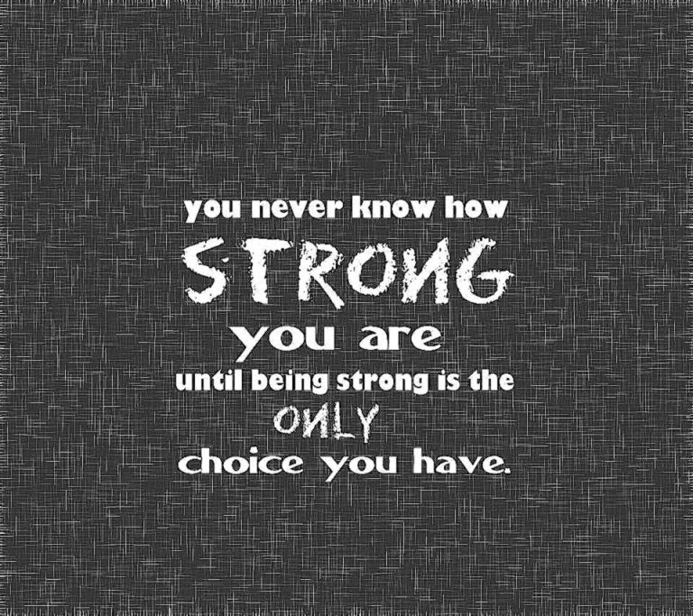
Veiled Threats to Haya
Dr. Kanwal Kaisser
Notes:
To view this presentation, first, turn up your volume and second, launch the self-running slide show.

Slide 2
Hadith on Haya
قَالَ رَسُولُ اللَّهِ صَلَّى اللَّهُ عَلَيْهِ وَسَلَّمَ مَا كَانَ الْفُحْشُ
فِي شَيْءٍ إِلَّا شَانَهُ وَمَا كَانَ الْحَيَاءُ فِي شَيْءٍ إِلَّا زَانَهُ
Messenger of Allah, ﷺ said, “Obscenity is not found in anything but that it spoils it, and modesty is not found in anything but that it beautifies it.” (Tirmidhi)

Slide 3
Veil….. Dictionary Meaning To cover or disguise
mask
covering
screen
Curtain
canopy
cloud
hide
conceal
Underlying
implicit
indirect
undetectable
Synonyms

Slide 4
Evident and not seriously taken
Regarded as safe
Comes in form of Hijab

Slide 5
Veiled Threat #1 Sexual Abuse

Slide 6
Myths
Statements | True | False
1. Children are relatively rarely abused.
2. Usually only girls are the victims of child sexual abuse.
3. Children may make up stories about being sexually abused.
4. Most often strangers sexually abuse children.
5. Sexual abuse generally occurs outside the home.
6. Child sexual abuse occurs mostly in poor, illiterate families.
7. Sometimes it is the child’s fault for being abused, because she/he has asked for it.
8. A child should be encouraged to forget about the abuse as there are no harmful effects of child sexual abuse.
9. Reporting of child sexual abuse can cause more harm than good.
10. People who sexually abuse children are under treatment of a psychiatrist for mental illness.

Slide 7
What is CSA?
Sexual abuse can be any sexual act performed with a child, to a child or in the presence of a child for the sexual gratification of another, ranging from unwanted touching, kissing to sexual intercourse. It can also involve solicitation, pornography, forcing, tricking, bribing, threatening, online enticements or pressuring a child into sexual activity.
Notes:
See: http://suite101.com/article/child-molestation-prevention-a46459

Slide 8
Statistics
One out of every three girls.
One out of every six boys (controversial)
Street Children in Pakistan
There is always a victim in our circle of family/friends/acquaintances

Slide 9
Indicators of CSA
Physical – through medical examination
Psychosocial – through behavior, acts, certain tendencies, withdrawal or indulgence etc.

Slide 10
Psychosocial Indicators
Younger children might use statements referring to their private parts or draw them and/or similar happening, giving subtle indicators
Fear or dislike of certain people or places
Older children might have problems in school, poor grades
Withdrawal from family, friends, or usual activities
Advanced sexual knowledge for the child's age
Regressed behavior, such as bedwetting
Eating disorders, eating very little or excessive eating
Hostility or aggressive behaviors (both in younger and older children)
Seductive behavior towards adults or peers
Suicidal thoughts or attempts

Slide 11
Profile of Abuser
Comes from all walks of life
90 % known to child
Very good con artists
Often a past victim of child molestation himself
Usually well-liked and respected community members

Slide 12
WHAT YOU CAN DO ABOUT IT
OUR RESPONSIBILITY

Slide 14
Why Children Can’t Tell?
Too young to put what has happened into words
Threatened or bribed
Fear that they will be taken away from their family
Are afraid no one will believe them
The abuser promised gifts or rewards for keeping the secret
Blame themselves
Feel too ashamed or embarrassed to tell

Slide 15
What to do?
Learn the Facts
Minimize opportunity
Educate child
Stay Alert
Leave nothing to chance

Slide 16
Veiled Threat # 2 Corporate World Competition

Slide 17
Corporate World Psyche
Competition Mania
Equally Intelligent
Career is important
Cant be Left out

Slide 18
Dangers for your Child
Immorality at peak
Materialism over exposure
Deen at Stake
Duniya vs Deen

Slide 19
Solution
Purpose of Life
Wise Career Choice
Clarity on Hijab limitations
Making right compromises

Slide 20
Veiled Threat #3 “Mahram” Relatives

Slide 21
OMG Cousins too?????
Relaxed
Young
Desires
No barriers

Slide 22
Cousins are non-Mahram
Sexual abuse
Temptation without fears
Childhood mindset can impact modesty
Marriage barriers

Slide 23
Solution
Careful Attitude
Clarity on Hijab
Inner Alarm reset
Teach Difference between Mahram and Non-Mahram

Slide 24
Veiled Threat #4 Use of Internet

Slide 25
Internet Access Dilemma
Gadgets
Wifi
No check and balance
Need of day

Slide 26
Kids watching 4 or more hours per day…
Put in less effort on school work
Have poorer reading skills
Play less well with friends
Have fewer hobbies and activities
More likely to be overweight

Slide 27
Fitnas….... Moreeeee Fitnas
Subliminal Messaging
Immodesty
Threat for Eman
Value Shift

Slide 28
Parenting in the Digital Age
When should you introduce your children to technology?
How much is too much?
How is technology changing the approach to parenting?

Slide 29
Tips to deal with media….
Halal and Haram on TV
TV Rules for Children
Don't Just do "Watching TV”
No Channel/net Surfing
Homework First
Watch Together
Never Use TV as Baby-sitter

Slide 30
Smaller Screen is Better
One TV is Better than Two
No Cable Channels
Encourage Commercial-Free Channels
TV Off Days
More Family Activities
Plan Your Time

Slide 31
Fight the Bad TV Programs
Stick to Your Guns
Many Follow You

Slide 32
Close Gateways to Immodesty
وَلَا تَقْرَبُوا الزِّنَا ۖ إِنَّهُ كَانَ فَاحِشَةً وَسَاءَ سَبِيلً
Nor come nigh to adultery: for it is a shameful (deed) and an evil, opening the road (to other evils). (Bani Israel: 32)

Slide 33
Obvious Hidden Motives
The Holy Prophetﷺ narrated: "Eyes commit adultery, and their adultery is the evil look; hands commit adultery, and their adultery is the use of violence; feet commit adultery, and their adultery is moving towards sin; the adultery of the tongue is (lustful) talk; and the adultery of the heart is the evil desire. In the end, the sexual organs either confirm all this (by their action) or disapprove of it." (Bukhari)

Slide 34
Zina of Eyes
World of Naked fashion
Crushes
Movies
Social Net Working
Reading Sexual stuff
Lower your gaze

Slide 35
Zina of Hands
Movement
What we hold with it
What we watch with it
What we open with it
Muslim Manicure

Slide 36
Zina of Feet
Movement
Where we go
What we wear
How we attract
Muslim Gait

Slide 37
Zina of Tongue
Dirty language
Alluring other gender
Gossip
Lie and cheat
Do Dhikr

Slide 38
Zina of Heart
Kuch Kuch Hota Hai
Engage in Healthy
Activities

Slide 39
What Haya does to us?
Sense of Ownership

Slide 40
Sign of life & faith
Sign of recognition(“Marfat”) of Allah
Sense of responsibility
Feeling of being answerable for own deeds

Slide 41
Lift veil from veiled threats
Call immodesty what it is
Learn and teach social skills
Be proactive
Look for modest role models
Learn and teach assertive skills
Focus on kid’s strengths
Make rules for yourself and kids

Slide 42
Narrated Sahl bin Sa'd: Allah's Apostleﷺ said, "Whoever can guarantee (the chastity of) what is between his two jaw-bones and what is between his two legs (i.e. his tongue and his private parts), I guarantee Paradise for him.” (Bukhari)

Slide 43
To get in touch….
Dr. Kanwal Kaisser/ Hamaray Bachchay
Dr. Kanwal Kaisser @ HamarayBachchay
hbheadoffice @gmail.com
www.hamaraybachchay.com

