Slide 1
Welcome Ramadan

Slide 2
Virtues of Ramadan
The best of all months
Rasulullah (saw) received his prophet hood in this month.
Quran revealed in this month.
Reward multiplied.
Night of power.

Slide 3
Gains of Ramadan
Controlling desires
Ibadah

Slide 4
What scares me….
Abu Huraira related that Rasulullah (saw) said: Many people who fast get nothing from their fast except hunger and thirst, and many people who pray at night get nothing from it except wakefulness (Darimi).

Slide 5
Allah Ta’ala tells us in Quran
شَهْرُ رَمَضَانَ الَّذِي أُنزِلَ فِيهِ الْقُرْآنُ هُدًى لِّلنَّاسِ
وَبَيِّنَاتٍ مِّنَ الْهُدَىٰ وَالْفُرْقَانِ ۚ فَمَن شَهِدَ مِنكُمُ الشَّهْرَ
فَلْيَصُمْهُ ۖ
Ramadhan is the (month) in which was sent down the Qur'an, as a guide to mankind, also clear (Signs) for guidance and judgment (Between right and wrong). So every one of you who is present (at his home) during that month should spend it in fasting (Al-Baqarah:185)

Slide 6
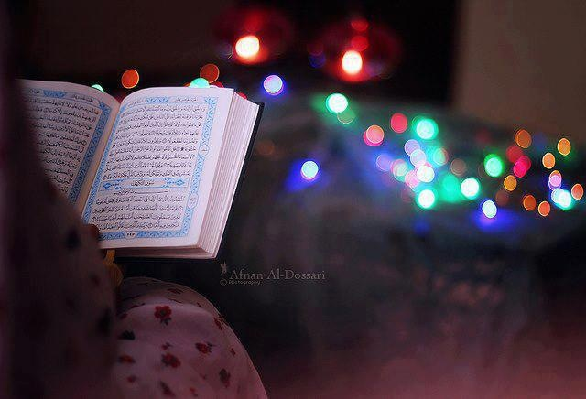
الْهُدَىٰ وَالْفُرْقَانِ

Slide 7
Why celebrate whole month for Quran??
يَا أَيُّهَا النَّاسُ قَدْ جَاءَتْكُم مَّوْعِظَةٌ مِّن رَّبِّكُمْ وَشِفَاءٌ لِّمَا فِي
الصُّدُورِ وَهُدًى وَرَحْمَةٌ لِّلْمُؤْمِنِينَ
قُلْ بِفَضْلِ اللَّهِ وَبِرَحْمَتِهِ فَبِذَٰلِكَ فَلْيَفْرَحُوا هُوَ خَيْرٌ مِّمَّا يَجْمَعُونَ
O mankind! there hath come to you a direction from your Lord and a healing for the (diseases) in your hearts,- and for those who believe, a guidance and a Mercy. Say: "In the bounty of Allah. And in His Mercy,- in that let them rejoice": that is better than the (wealth) they hoard. (Surah Yunus: 57-58)

Slide 8
Why celebrate Quran with Fasting and Taraweeh??

Slide 9
Two responsibilities
وَكَذَٰلِكَ جَعَلْنَاكُمْ أُمَّةً وَسَطًا لِّتَكُونُوا شُهَدَاءَ عَلَى النَّاسِ
Thus, have We made of you an Ummat justly balanced, that ye might be witnesses over the nations (Al-Baqarah:143)
Understand and follow
Pass the message on to others

Slide 10
Power we need to fulfill this responsibility ….
تقویٰ

Slide 11
Connection of Ramadan and Taqwa
يَا أَيُّهَا الَّذِينَ آمَنُوا كُتِبَ عَلَيْكُمُ الصِّيَامُ كَمَا كُتِبَ
عَلَى الَّذِينَ مِن قَبْلِكُمْ لَعَلَّكُمْ تَتَّقُونَ
O ye who believe! Fasting is prescribed to you as it was prescribed to those before you, that ye may (learn) self-restraint (Al-Baqarah: 183)

Slide 12
Taqwa… “to abstain from”
Driving force
Awareness package
Conviction and determination
Discipline…principle centered lifestyle
Stop from wrong and stick to good

Slide 13
Taqwa teaches us…..
Accept Allah Ta’ala as supreme authority in our lives
Remember He has all possible and impossible powers.
We walk, talk, eat, act according to HIS order.

Slide 14
In heart…… دل کا معاملہ
Abu Hurayrah (RA) said: The Messenger of Allah (saw) said:
“Do not have envy of one another. Do not inflate prices on one another. Do not hate one another. Do not turn your backs on one another. Do not undersell one another; but rather, be worshipers of Allah and brothers. The Muslim is the brother of his fellow Muslim. He does not oppress him, nor does he abandon him, nor does he lie to him, nor does he belittle him. Taqwa is here” and he pointed to his chest three times. “It is a sufficient act of evil that a person belittles his Muslim brother. Every Muslim to another Muslim is sacred, his blood, his wealth, and his honor.”
[Sahih Muslim]

Slide 15
Combo deal
Tilawat Quran
Fasting
Qayyam ul layal
Taqwa

Slide 16
Rise above your needs
Esteem
Social
Safety
Physiological
Self Actualization
Learning outcome: If taqwa in heart one can rise above all needs.

Slide 17
For Allah Alone
Abu Huraira related that the Prophet(saw) said: Allah the Majestic and Exalted said:
"Every deed of man will receive ten to 700 times reward, except Siyam (fasting), for it is for Me and I shall reward it (as I like). There are two occasions of joy for one who fasts: one when he breaks the fast and the other when he will meet his Lord"
(Muslim).

Slide 18
Benefits of Taqwa
Guidance
Help from Allah
Allah’s love
Best spot with Allah
Knowledge and wisdom
Protection
Way out of all problems
Ease in all deeds

Slide 19
Warm up in Month of Sha’ban What to do now?

Slide 20
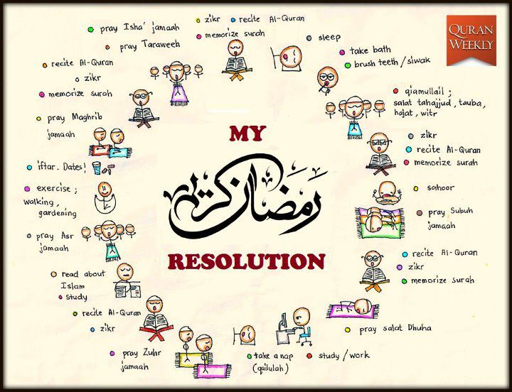

Slide 21
1. Intention
Awareness
Effort
Purity
Drill of focus message

Slide 22
2. Connection with Quran
Recite daily
Listen to any good Qari
Attend study circles of Quran
Listen on line
Don’t miss Taraveeh
Comprehension

Slide 23
3. Avoid sinning
Make list of some bad habits
Pick a target for the month
Make a strategic plan to implement it
If one plan fails, think of another alternative
Give yourself penalty for errors.
Abu Huraira related that the Prophet said: If a person does not avoid false talk and false conduct during Siyam, then Allah does not care if he abstains from food and drink (Bukhari, Muslim).

Slide 24
4. Striving for Amal e Saleh
Criterion is: Quran and Hadith
Haqooq Allah
Haqooq Ibadh

Slide 25
5. Qiyam ul layl
On priority
Choosing best masjid
Taking friends along
Trying to understand verses
Seeking loads of Istaghfar
Aisha related that the Prophet (saw) said: Look for Lailat al-Qadr on an odd-numbered night during the last ten nights of Ramadan (Bukhari).

Slide 26
6. Dhikr and Dua
Formal
Informal

Slide 27
7. Seeking night of power and Aitikaf
Turbo Speed in last 10 days
Sessions at night for Ibadah with family , friends and in masjid
Connect to Allah Ta’ala more deeply
لَيْلَةُ الْقَدْرِ خَيْرٌ مِّنْ أَلْفِ شَهْرٍ

Slide 28
8. Spending
Zakat
Family
Relatives
Poor
Sadiqa Jaria projects

Slide 29
9.Community work
Empathy
Sharing
Reaching out in community projects
Orphanages
Hospitals

Slide 30
10. Connecting people to Quran
Target someone close
Take him along to all places
Convey message in beautiful manner
Introduce people to good scholars, lectures, websites

Slide 31
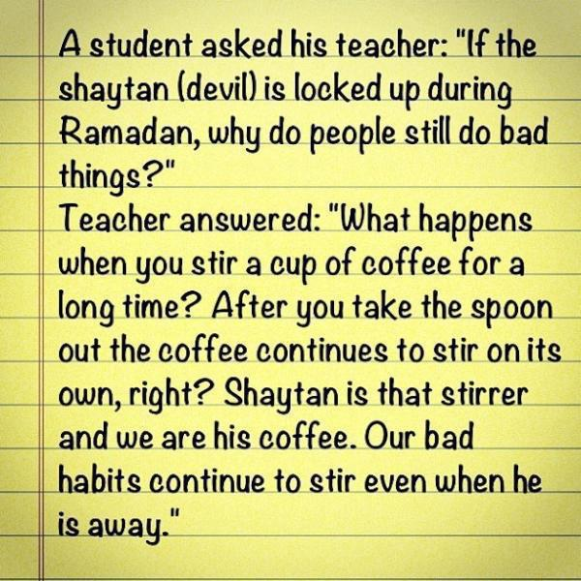

Slide 33
Stay Charged

